Slide 1
TSQLx Engine-Data Modeling Final Project
By: Sean Domingo, Michael Frederick, Megan Molumby, Mai Nguyen, Richard Pratt
Gold Team

Slide 2
Overview/Description
Implemented a temporal database for a SQL and XML software package called TSQLx.
This engine has the capability to receive and run commands such as:
Create database/table
Load database
Delete from table
Insert to table
Query Table
The engine is able to receive XML files and convert them into an output file of SQL commands which are then outputted to the database.

Slide 3
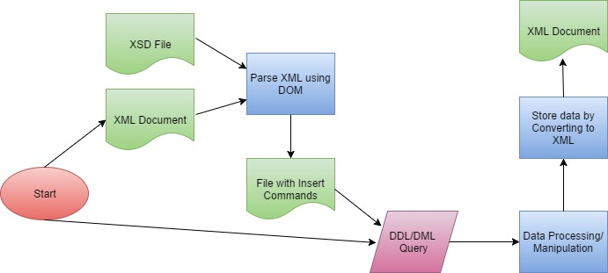
TSQL Engine Software Design
Notes:
The engine is written in Java and the database is stored in XML file format.

Slide 4
Database Design
All files are stored in XML format.
The database catalog stores an XML file for each database. Each file
Stored Data in XML file format for the following reasons:
Had to utilize a DOM Parser to handles the conversion of XML to SQL
Able to reuse code without creating new program to retrieve data and manipulate data
Notes:
Parser breaks down the XML file into a tree structure
Able to easily modify, delete and create elements in an XML file

Slide 5
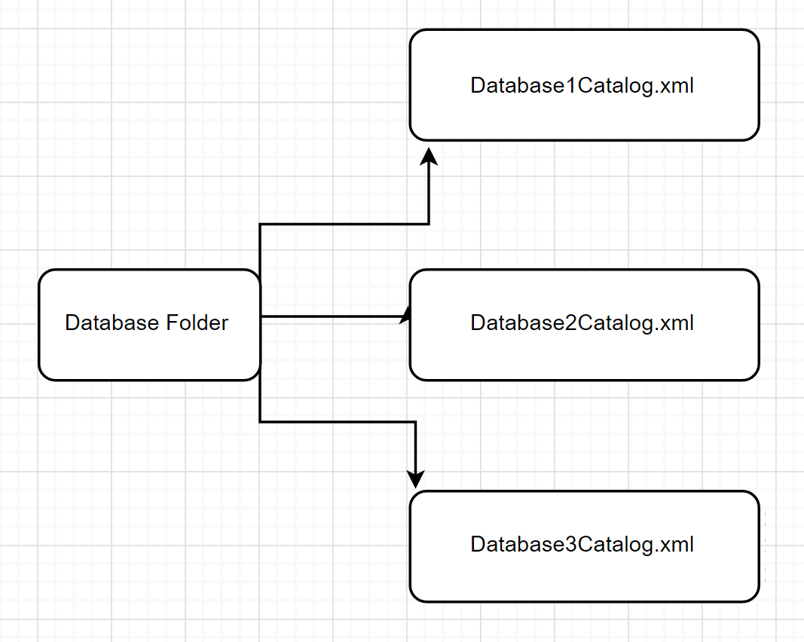
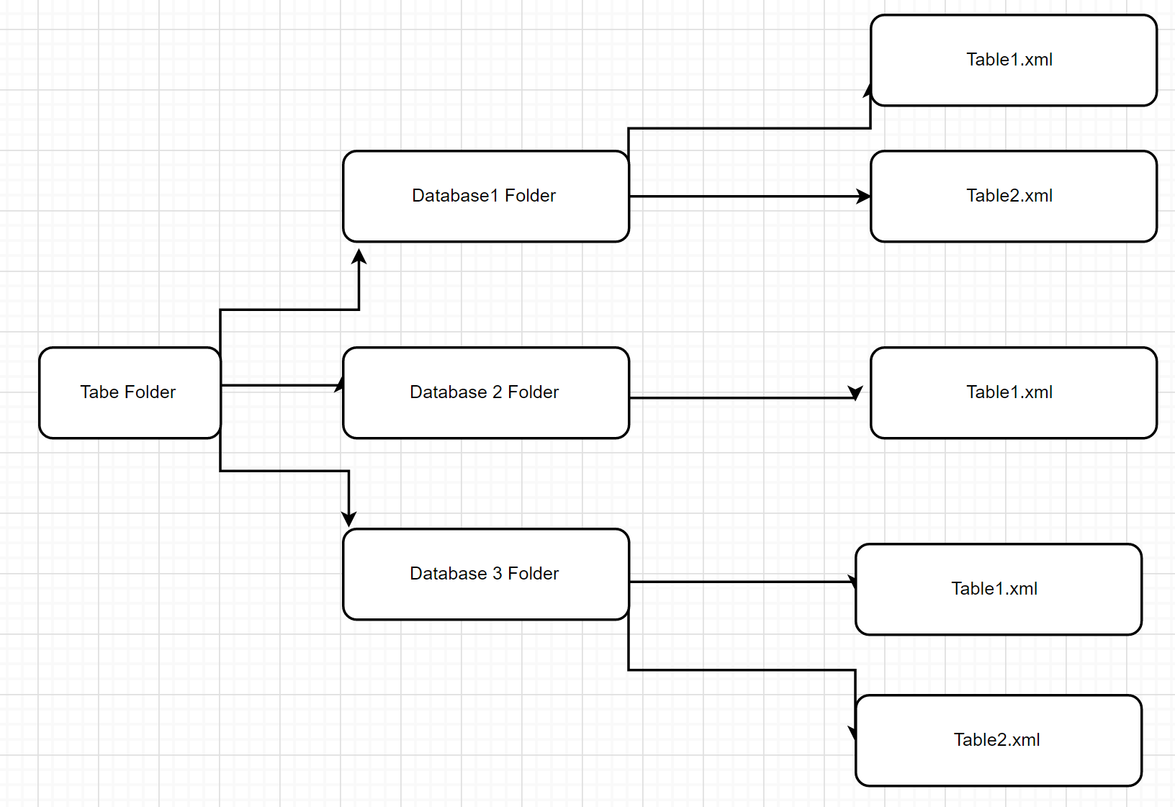
DATABASE/CATALOG DIAGRAM

Slide 6
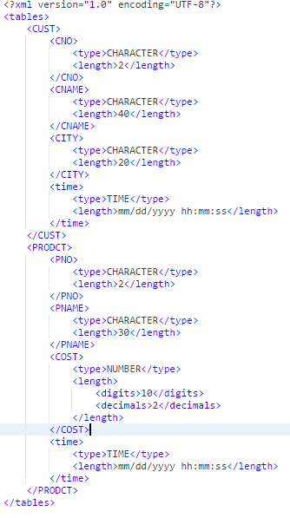
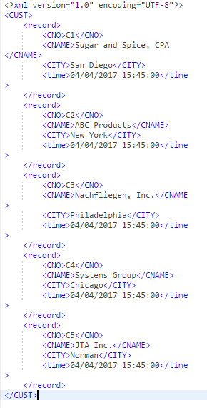
Example Catalog in XML Format
Example Table in XML Format

Slide 7
SQL Command Implementation

Slide 8
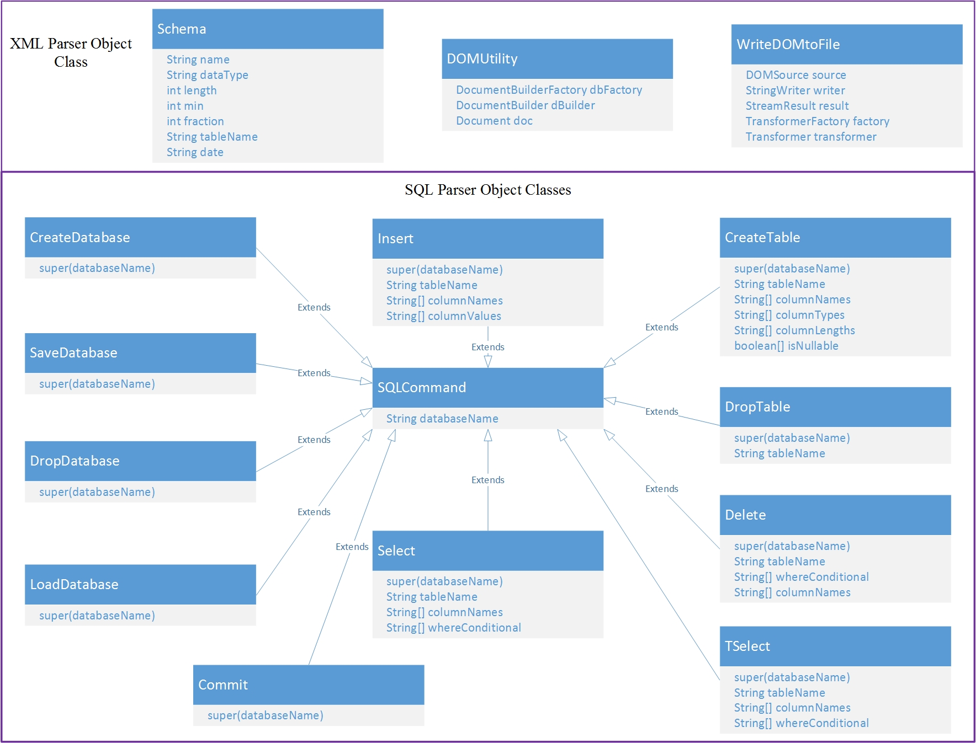
Notes:
This is an overview of our SQL command implementation classes.
All SQL commands extend the SQL Command class, which holds the database Name

Slide 9
XML DOM Parsing
Utilizing the DOM Parser library enabled easy manipulation of XML files to:
modify XML files
delete elements in XML File
create new XML FIles
query XML Files

Slide 10
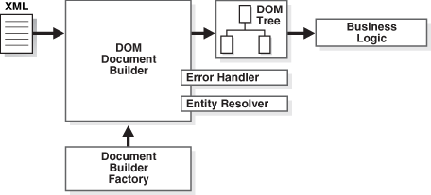
DOM Utility ()
Notes:
created a class called DOM utility that creates all of these objects so that each command that utilizes it can just call the class.
transform

Slide 11
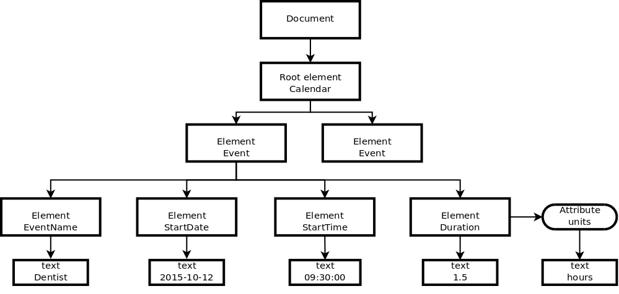
DOM Tree
Notes:
INSERT
DELETE
SElect
tselect
where conditions
ith Dom parser, the XSD file schema is parsed for data types and are compared to XML file.
The XML file is transformed into an SQL file that produces output objects for each command
The commands are then applied to the file in the database during a DDL/DML query
This prompts the data processing and manipulation of the file
The new data is stored and the file is converted back to an XML document

Slide 12
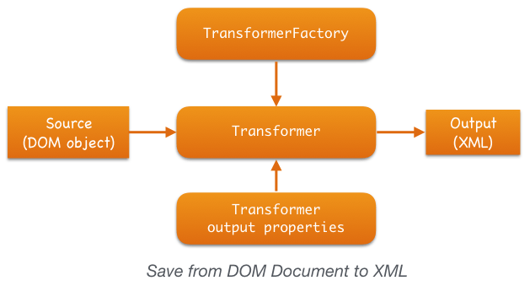
WriteToDom File()
Notes:
delete, insert,

Slide 13
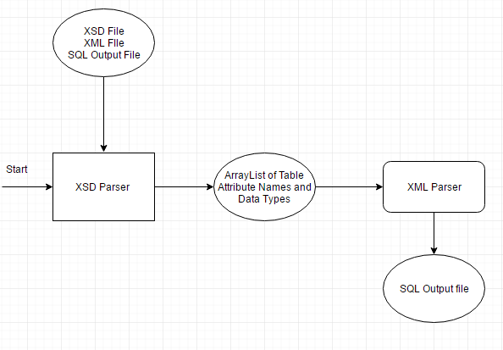
CONVERT XML to SQL input file

Slide 14
QUESTIONS?

